Slide 1
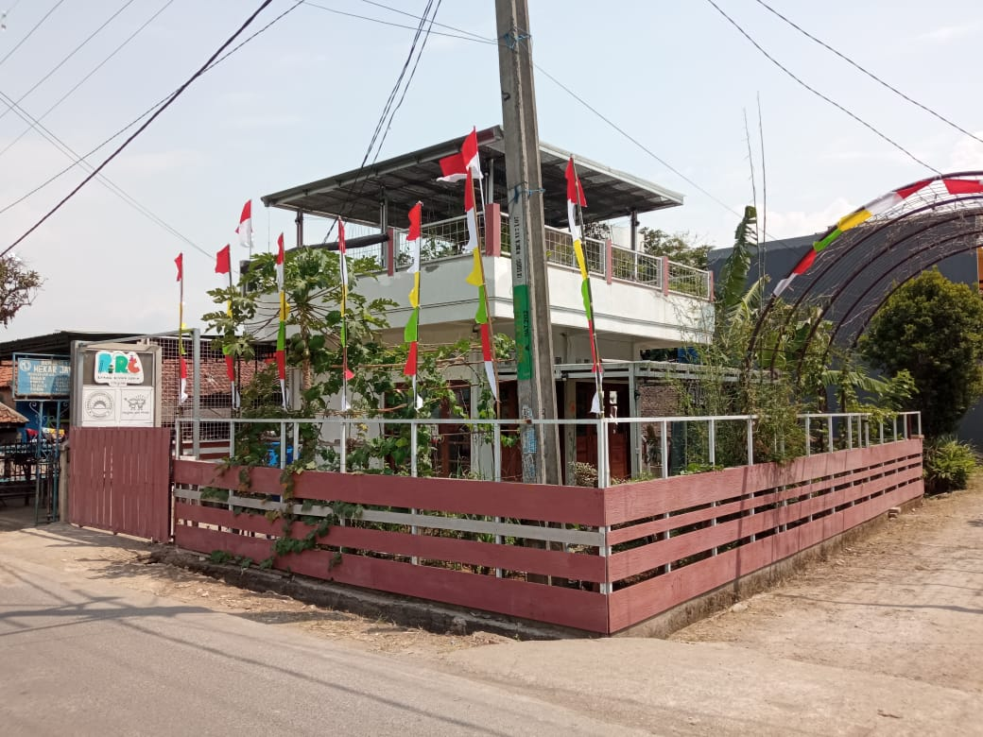
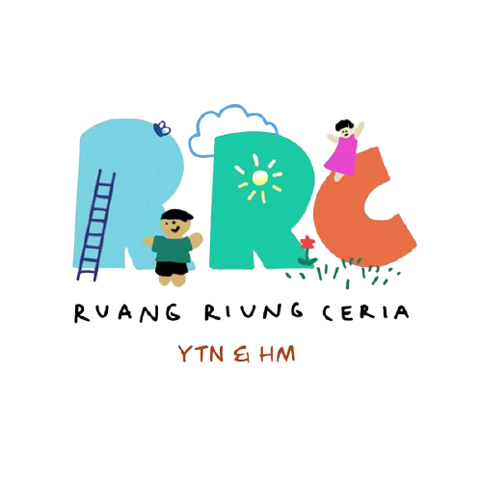
A Tunas Nusa & Heights and Minds Foundation Partnership
Stunting is still a problem that must be solved in Indonesia.
Based on the results of
the 2019 Toddler Nutrition Status survey, the prevalence of stunting in Indonesia reached 27.6%
One of the challenges is the lack of public understanding of stunting.

Slide 2
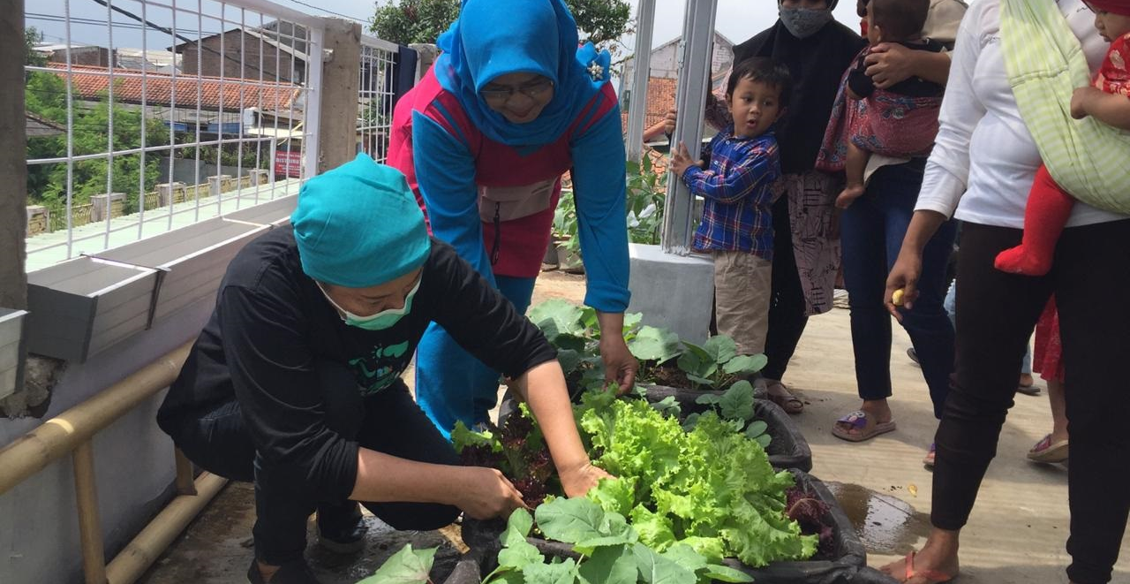
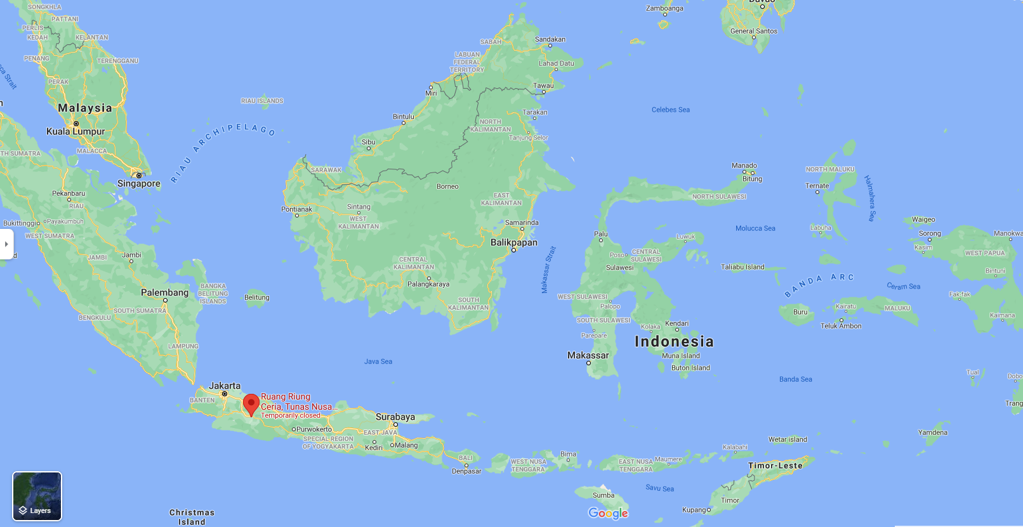
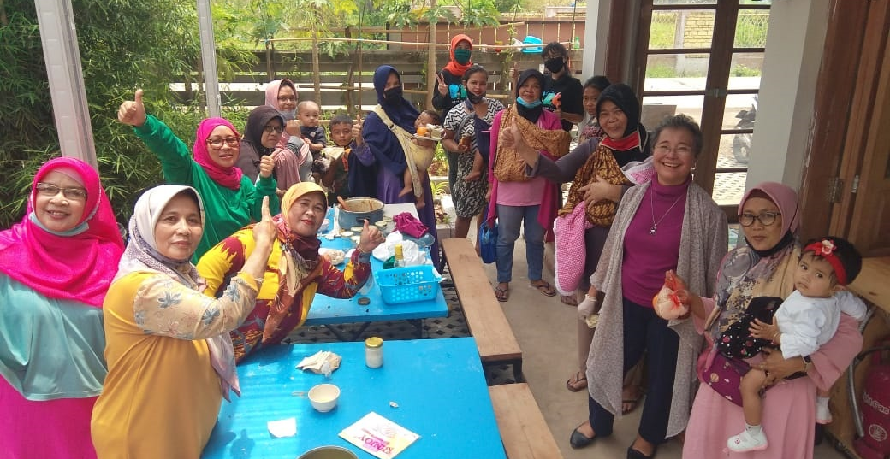
RRC opened its doors in Rancaekek, Bandung, West Java, Indonesia on January 1, 2021.
Despite closings due to COVID-19, RRC has welcomed 300+ women and children since then.
The main focus of Ruang Riung Ceria (RRC) is stunting prevention.
For this they use an inclusive approach where specific target groups are arranged in each of RRCs activities.
There are 3 categories of target groups,
divided by the priority roles to prevent stunting:
Pregnant women, lactating women, and children under 2 years old
Children, adolescents, and teenagers
The rest of the community, including senior citizen (grandparents)

Slide 3
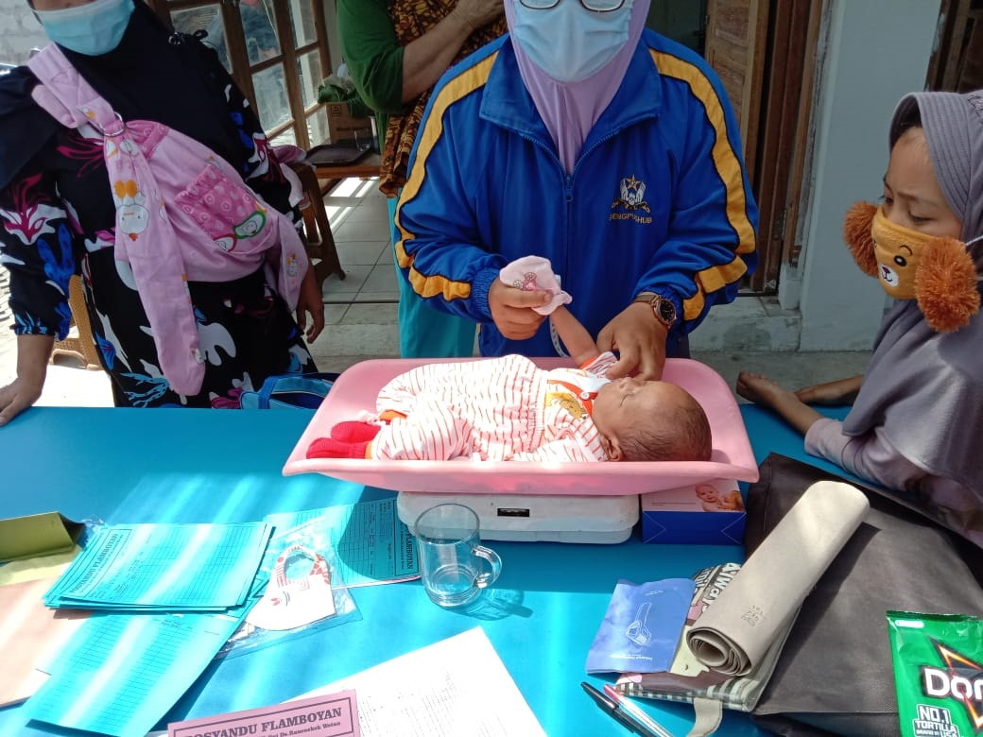
RRC Activities
Food Security Improvement Activities:
1. Shopping experiment market
2. Shopping experiment to kiosk
Gardening workshops
(Planting vegetables, mushroom cultivation)
Activities for the first and second target group are currently prioritized.
Growth monitoring and promotion services
Knowledge development
Cooking workshops

Slide 4
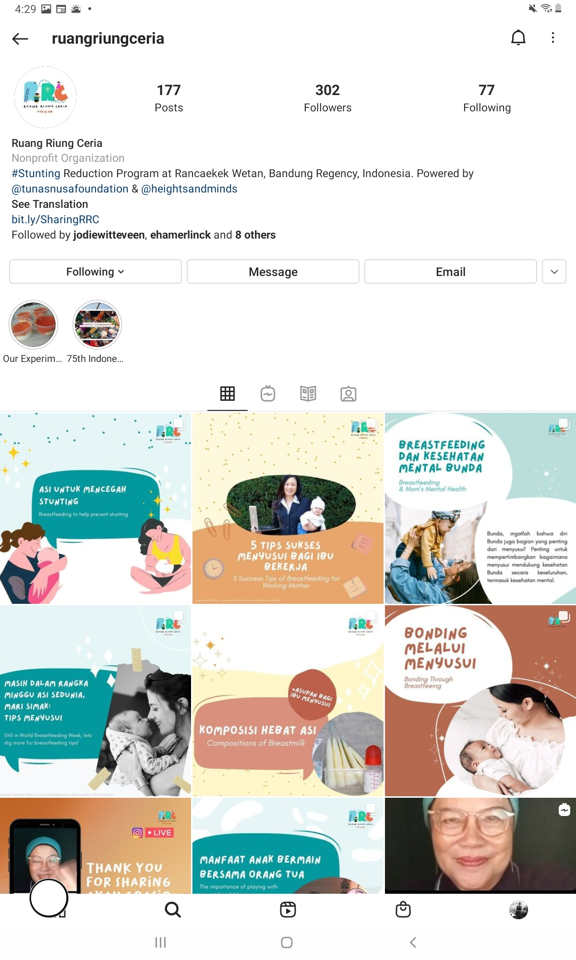
Outreach and social media
RRC aims to raise awareness of the importance of stunting prevention via social media by sharing educative content about stunting, pregnant & lactating mothers, healthy lifestyle, parenting, clean environment, and more.
WhatsApp, Instagram, Facebook were chosen as social media channels because of the high number of users in Indonesia.
The RRC Instagram is started in December 2020 and now has more than 300 followers.
Most users RRC have reached come from Bandung. While the rest are users from Jakarta, Bogor, Bekasi, Surabaya.
During the COVID-19 lockdown a WhatsApp group chat is used to reach RRC's main target group (pregnant women and young parents).
@ruangriungceria

Slide 5
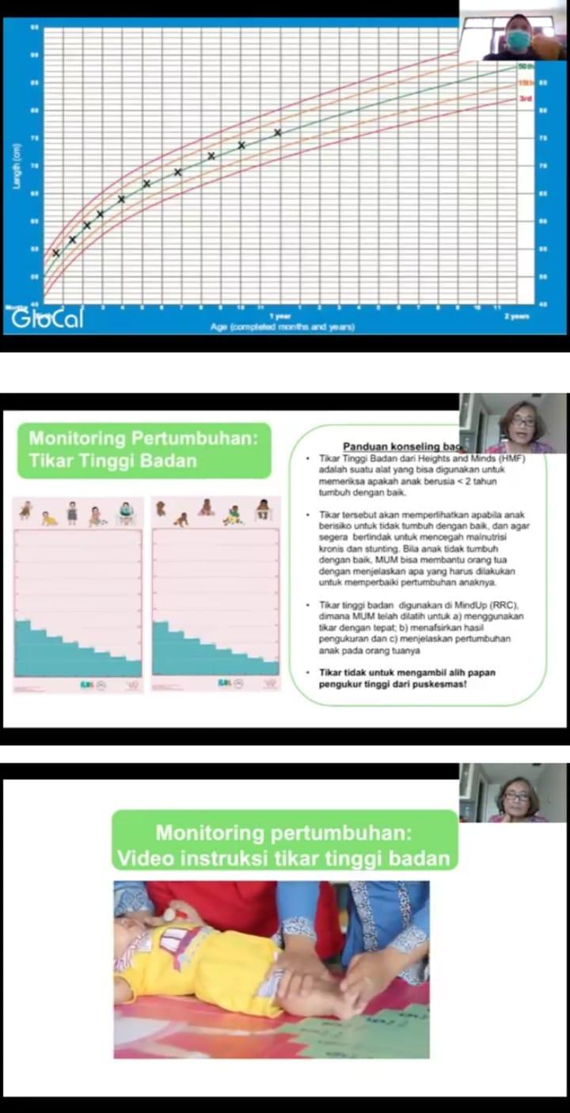
In April 2021, Heights and Minds provided a training on Growth Monitoring and Promotion (GMP) to assure high quality Child GMP services at RRC.

Slide 6
Budget and costs
Note: 1 USD = 14408,30 IDR

Slide 8
In order to ensure the sustainability of RRC, there’s a need to be financially
independent.
Therefore, Heights and Minds Foundation will provide the operational
funds for three years while Tunas Nusa develops funding system suited for the regional, cultural, economic condition of the area to be financially independent.

Slide 9
Next steps: September 2021 onwards
Optimizing Child GMP services
Continuing Heights and Minds E-learning training for MindUp Managers
Introducing Heights and Minds Highway platform: IT company ServiceHeroes is providing Heights and Minds with a license to their ServiceHighway platform, a multilayered platform with multiple applications. Soon this platform will be used at RRC to minimize reporting and administrative requirements while at the same time maintaining real-time data availability and transparency.
Testing first 1,000 days survey with target group: Heights and Minds Foundation started developing a survey as a monitoring and evaluation tool for the services provided by RRC.
Entrepreneurship activities: RRC will look at several sources of funding in order to operate financially independent within 3 years. One of them is socio-entrepreneurship; using profit obtained by selling RRC's products to fund the program.
During COVID-19 lockdown: Optimizing communication, information and learning activities through social media

