Slide 1
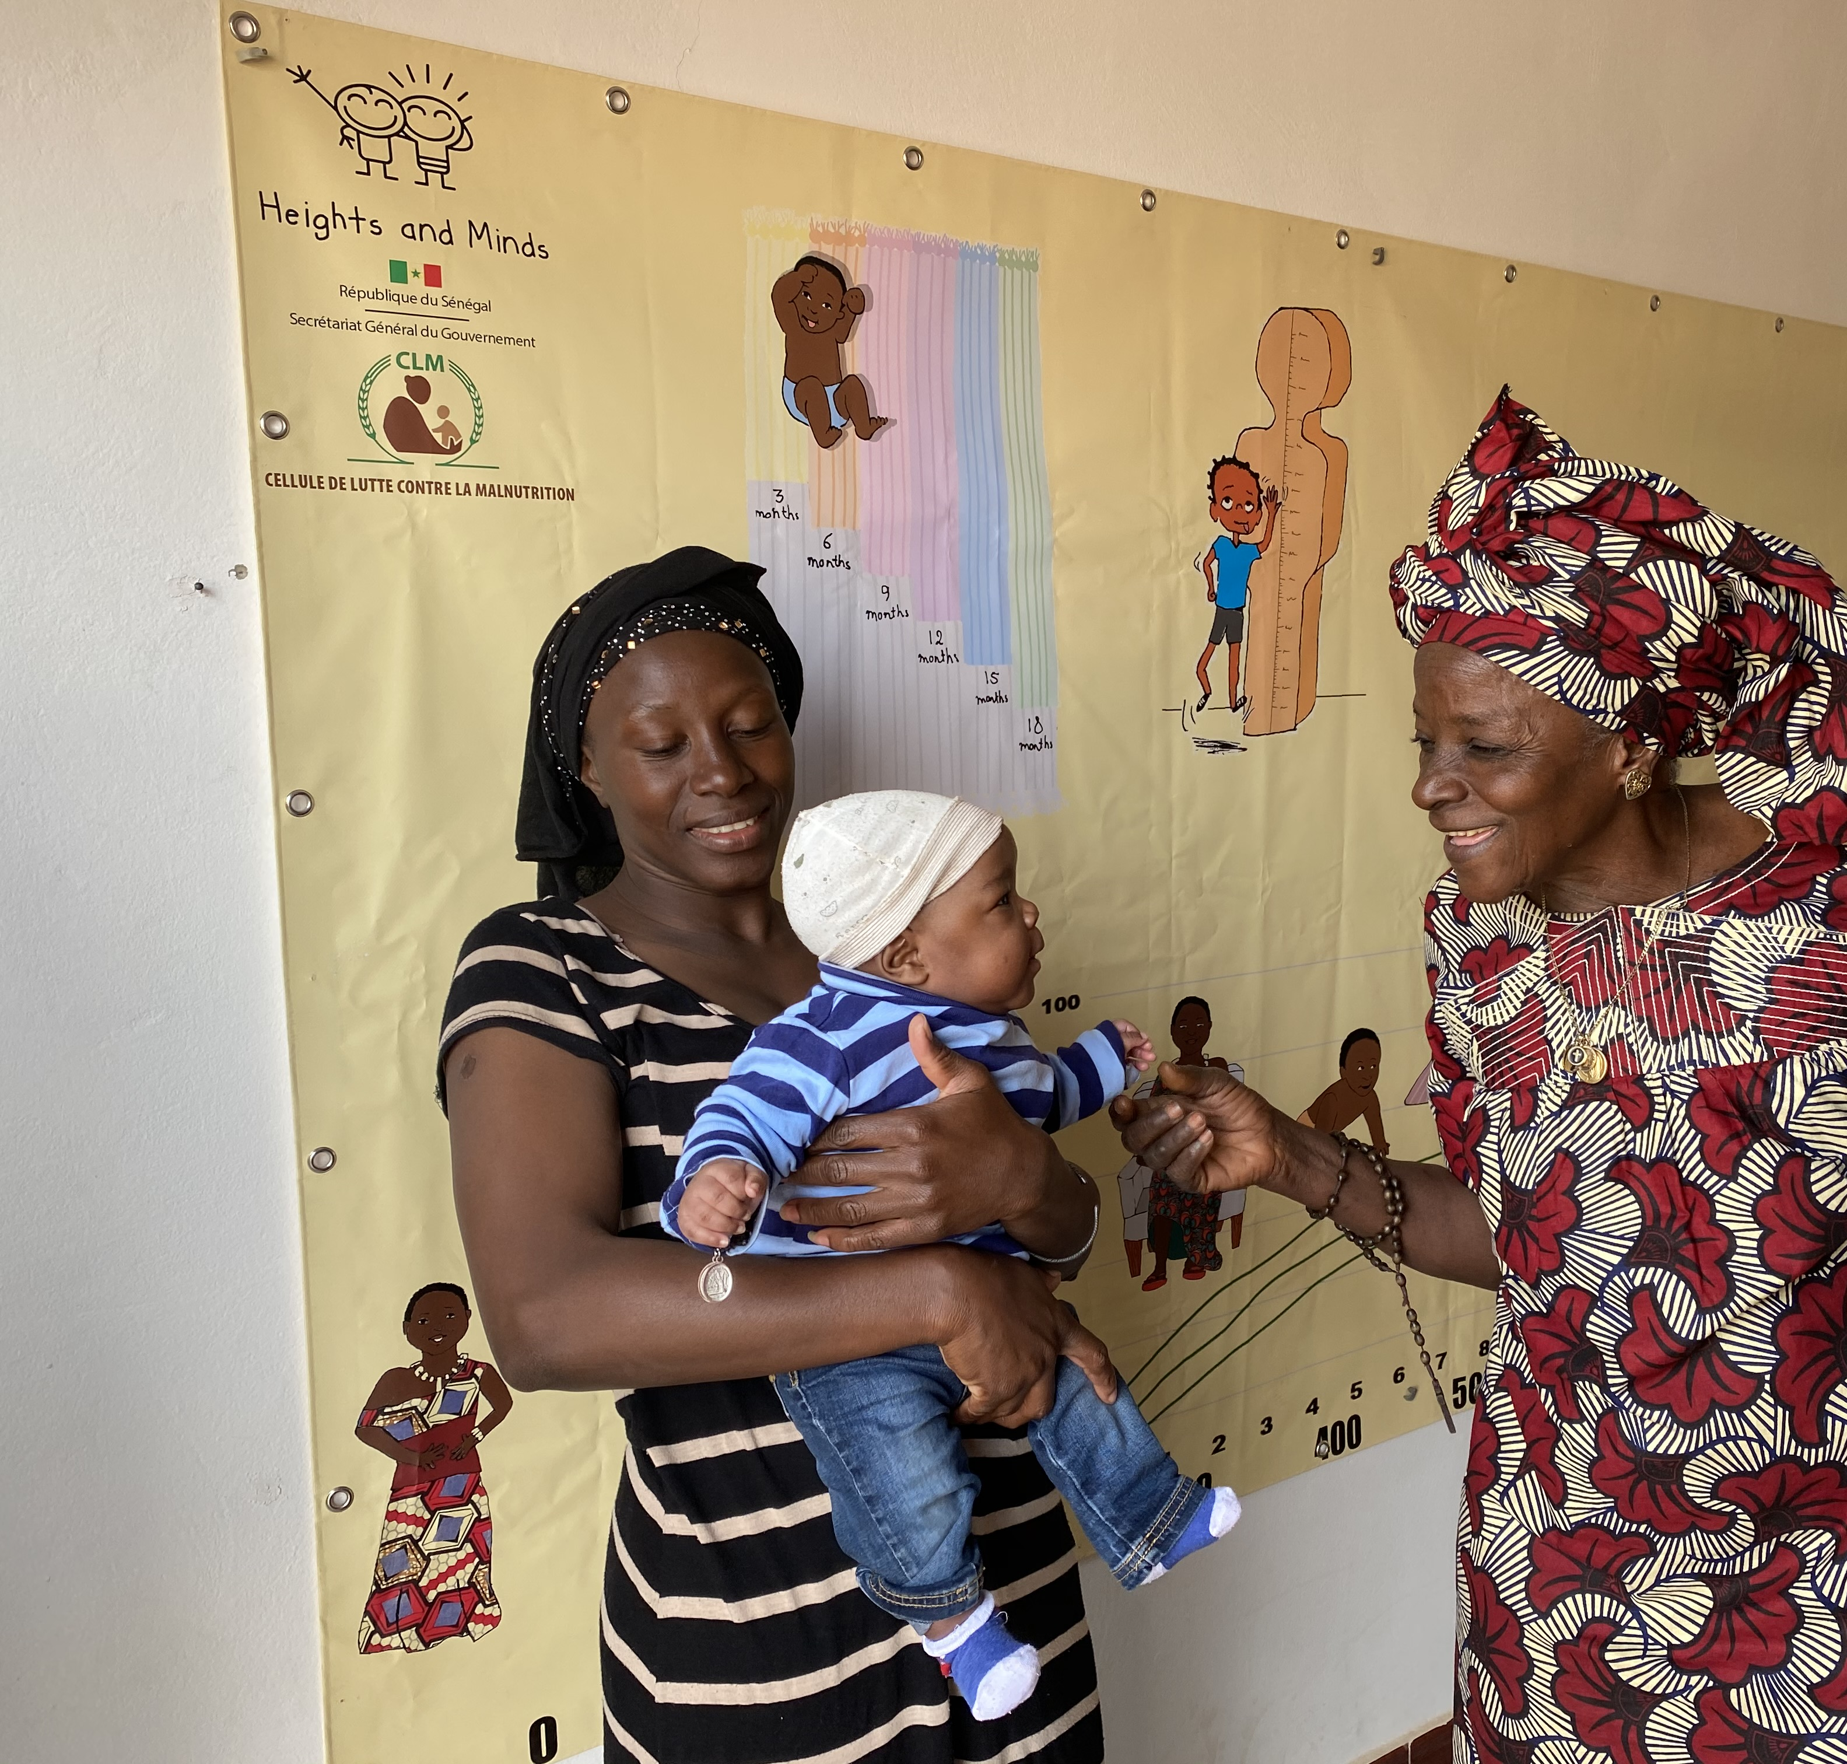
Tawfekh Keur Jaboot
Gouy Goui
CNDN
Heights and Minds Foundation

Slide 2
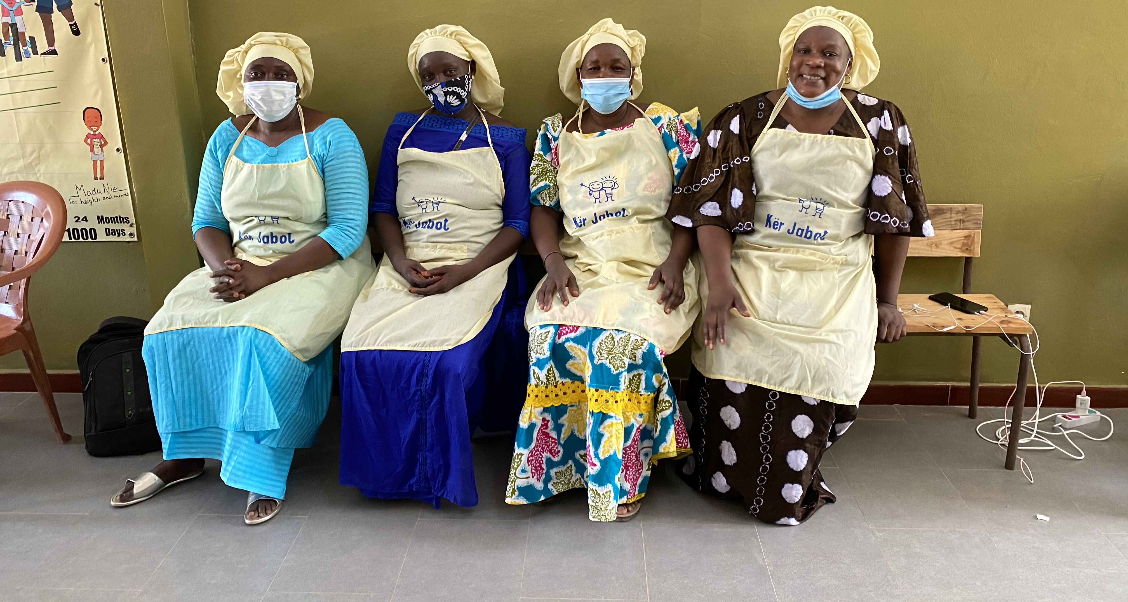
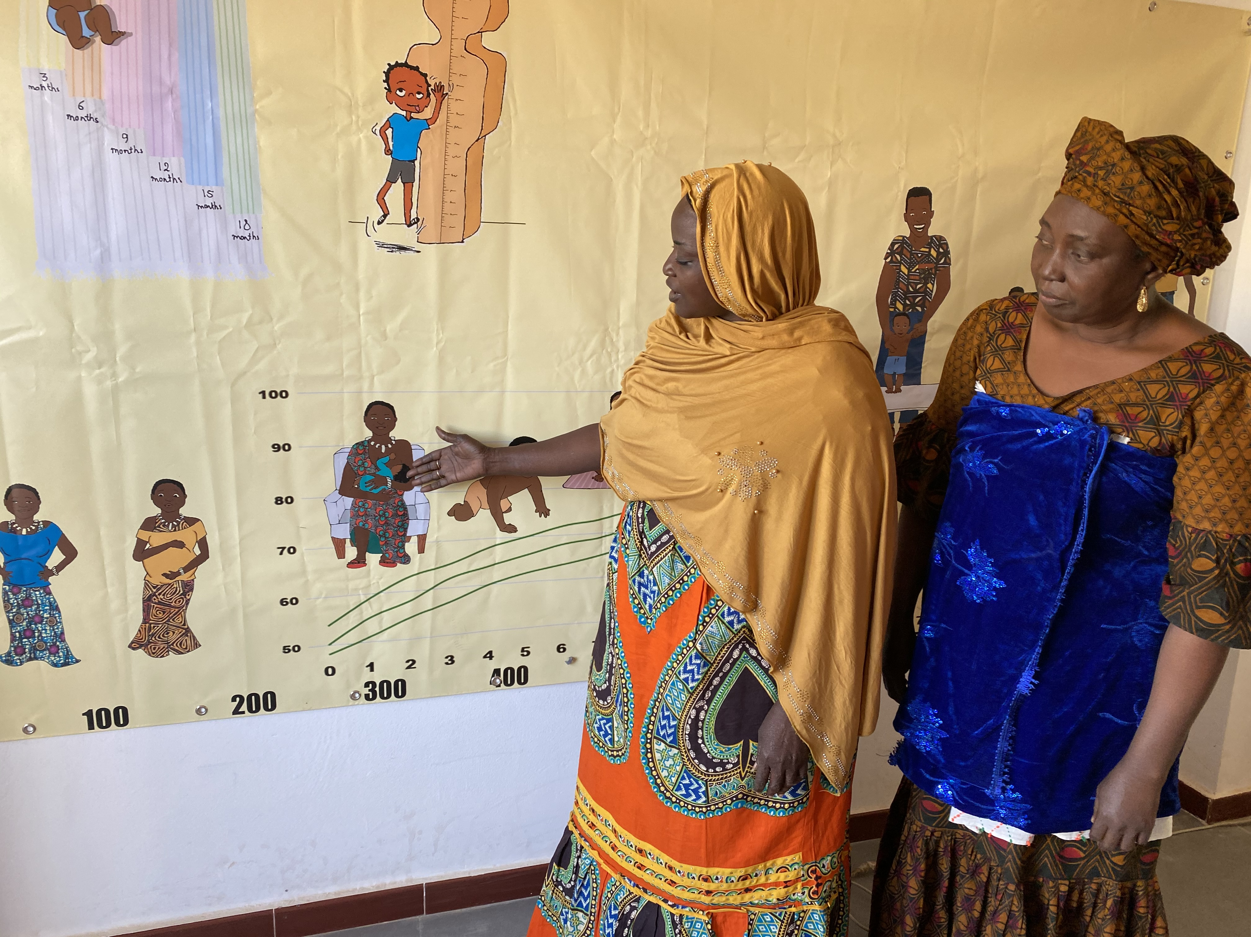
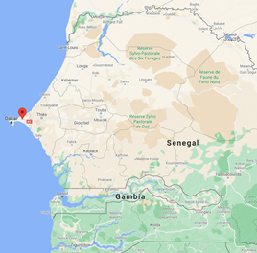
The Heights and Minds Foundation signed a partnership with the National Nutrition Council in Senegal, Conseil National de Développement de la Nutrition, to develop the MindUp concept in Senegal and establish various MindUps as pilots in Greater Dakar and Thiess.
The MindUp “Tawfekh Keur Jaboot”- situated in Jaxaay (Greater Dakar) ran by the NGO Gouy Gui - was the first one to open in Senegal.
Since the opening in January 2020, they have been open for 35 weeks with an average of 7 hours per day.
​
The target group is mostly pregnant women and children 6-24 months old. Nowadays, more than 200 children under 2 years old are registered in the Tawfekh Keur Jaboot database. Every month, over 100 pregnant women and young parents are making use of the growth monitoring and promotion services provided.
Updated: August 2021

Slide 3
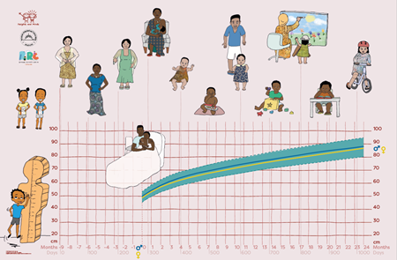
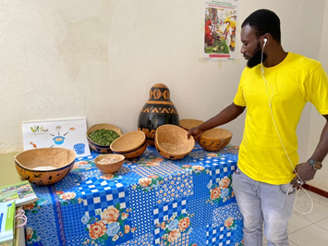
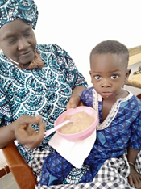
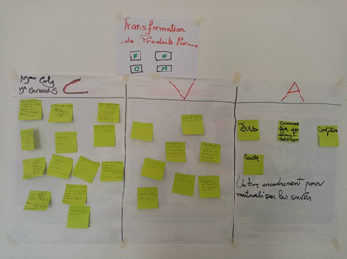
Growth Monitoring and Promotion (GMP)
Cooking and sanitation demonstrations
Services and Activities Tawfekh Keur Jaboot
Daily meal service
Causerie

Slide 4
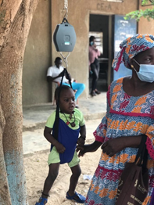
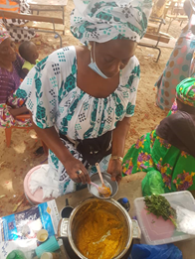
Outreach & communication strategy
Most communication and promotion of the services provided by Tawfekh Keur Jaboot goes by word of mouth or via the local health centre. There is not much promotion material, posters and flyers are missing.
When the COVID-19 situation is better in Senegal, they are planning to have a big opening/promotion event with local authorities.
In July 2021, Tawfekh Keur Jaboot held a promotion event in one of the other districts of Jaxaay to promote the services they provide. During this event, GMP was performed and healthy dishes for young children were distributed.
In the future there is an idea to provide a transfer to the TKJ from other districts of Jaxaay to reach a wider audience.

Slide 5
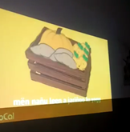
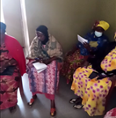
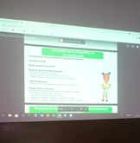
The Height and Minds E-learning training with Tawfkeh Keur Jaboot virtually took place in the period of March – April 2021. This training was provided to assure high quality Child GMP services.
According to them, the GloCal videos in Wolof were a great contribution to the E-learning modules.
E-learning training

Slide 6
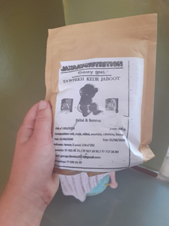
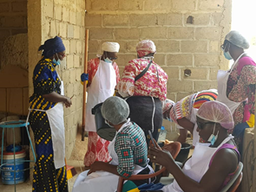
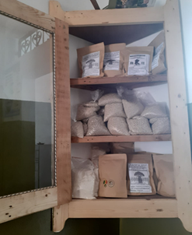
Income generating activities
Tawfekh Keur Jaboot gets a montly budget from the HMF, this is around CFA 330 000 (€ 500.00) a month. From this budget the monthly expenses should be covered such as salary of two MUMs and the operational costs.
Tawfekh Keur Jaboot comes up with their own income generating activities as part of being able to operate financially independent within 3 years, examples are the production and sale of Farine (a nutritious flour) and soap.

Slide 7
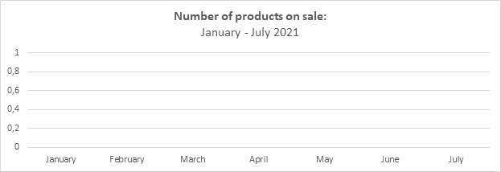
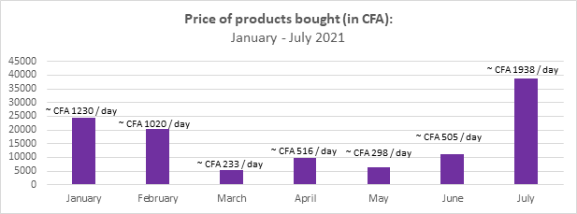
Financial data

Slide 8
Financial data
Note: In 2021 no products were sold because of the COVID-19 situation during those months.

Slide 9
Next steps: September 2021 onwards
Stimulating individual counselling and testing the HMF Highway Platform:
Face-to-Face training of the MUMs to strengthen the Child GMP services (perform anthropometric measurements, registration, individual counseling)
Test HMF Highway Platform: making the shift from registry on paper to everything online
Organizing the services
A weekly/monthly plan should be made for the provision of the services, when to provide GMP services, cooking demonstrations etc.
Making a plan to regulate women visiting the center (nowadays 100+ women are registered in the TKJ database)
Reorganizing space: separate the space where the services are held, and where women can talk with each other and watch educative videos
E-learning training
Ask the CNDN for feedback on the E-learning modules
Test the Heights and Minds E-learning modules with the MUMs, document the experience and recommend local adaptations for the current modules
Strengthen Communication Strategy
Strengthen Communication Strategy, through:
- Posters and flyers
- A more attractive head sign above Tawfekh Keur Jaboot
- Radio emissions
- Promotion events
- Social media platforms
Strengthen Financial Strategy
Strengthen Financial strategy, through:
- Cost-effectiveness plan for the production of Farine and soap
- Face-to-Face training of the MUMs to strengthen management, entrepreneurial skills
- Market research Jaxaay

